Slide 1
01 • ABSTRACT
CampusVoice: NLP-Based Student Feedback Intelligence
Automatically converting unstructured student comments into structured academic insights.
Abstract
CampusVoice is an NLP-based student feedback intelligence system designed to analyze natural-language student comments automatically. The system processes 726 feedback records using text preprocessing, negation handling, TF-IDF word and character n-gram features, and Logistic Regression. It predicts sentiment as Positive, Neutral, or Negative and identifies the relevant academic category. A hybrid sentiment layer combines the ML model with VADER and domain-specific rules to improve robustness on unseen feedback. Each prediction includes confidence information and is delivered through a FastAPI backend and React interface for analysis, dashboards, insights, and feedback exploration.
Student feedback
NLP processing
Prediction
Campus insight
Core workflow
Netra Neman – 231A013
01

Slide 2
02 • NLP IMPLEMENTATION
How the feedback text is processed
The NLP pipeline is the main technical contribution of the project.
1
2
3
4
5
6
Text input
Preprocessing
Negation
TF-IDF
ML model
Output
Raw student comment
Cleaning + normalization
Detect “not good” patterns
Word + character n-grams
Logistic Regression
Label + confidence
Feature engineering: TF-IDF
Negation-aware processing
“The laboratory facilities are not good.”
→ NEGATIVE
• Word n-grams capture meaningful words and phrases.
• Character n-grams capture partial word patterns and spelling variations.
• Both representations are combined before classification.
Negation detected: YES
The pipeline prevents a positive word such as “good” from being interpreted without its surrounding negation.
CAMPUSVOICE • NLP STUDENT FEEDBACK INTELLIGENCE
02

Slide 3
03 • SENTIMENT ANALYSIS
How sentiment analysis was implemented
A hybrid approach combines supervised learning with rule-based and lexicon-based signals.
A. MACHINE LEARNING
B. VADER
C. DOMAIN RULES + NEGATION
Logistic Regression
Lexicon-based signal
• Education-specific sentiment terms.
• Explicit negation detection.
• Helps handle obvious unseen feedback cases.
• Word + character TF-IDF features
• Trained on labeled feedback
• Predicts Positive / Neutral / Negative
• Model probability provides confidence
• Produces a compound sentiment score.
• Adds an independent sentiment signal.
• Useful for strongly worded short feedback.
ML
+
VADER
+
Rules
Example
84.14%
“terrible”, “breaking” → strong negative signal
FINAL SENTIMENT + CONFIDENCE
accuracy
CAMPUSVOICE • NLP STUDENT FEEDBACK INTELLIGENCE
03

Slide 4
04 • RESULTS
Model results and what they mean
The sentiment model is stronger than category classification, so confidence is shown to the user.
84.14%
≈0.8435
66.44%
726
Sentiment accuracy
Sentiment F1 score
Category accuracy
Feedback records
Interpretation
What the system returns
• Sentiment prediction performs well on the evaluation set.
• Hybrid rules are an enhancement for unseen feedback, not a claim of perfect accuracy.
• Category classification is more challenging and is therefore presented with confidence.
• Sentiment label
• Sentiment confidence
• Predicted academic category
• Category confidence
• Negation detected / analysis method
CAMPUSVOICE • NLP STUDENT FEEDBACK INTELLIGENCE
04

Slide 5
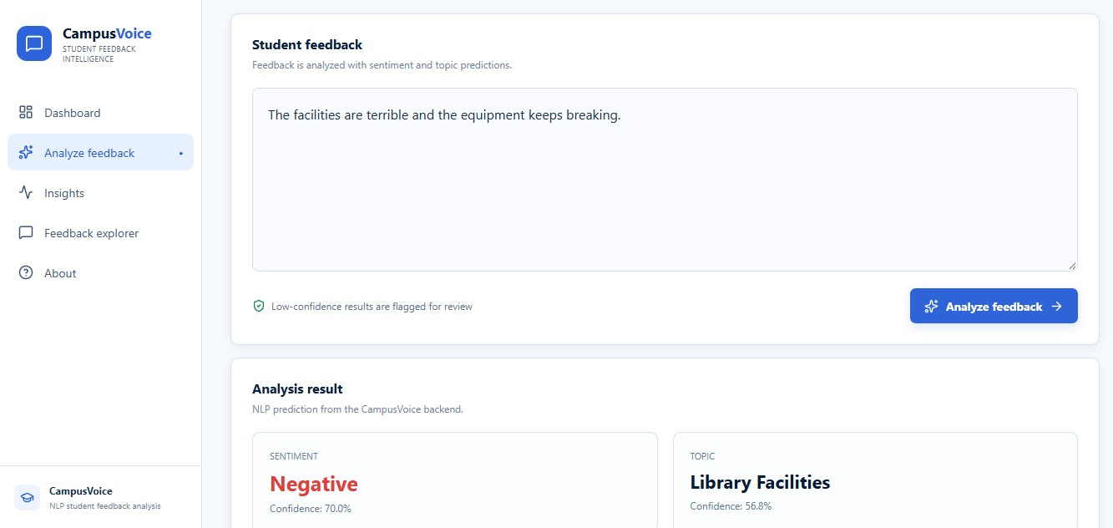
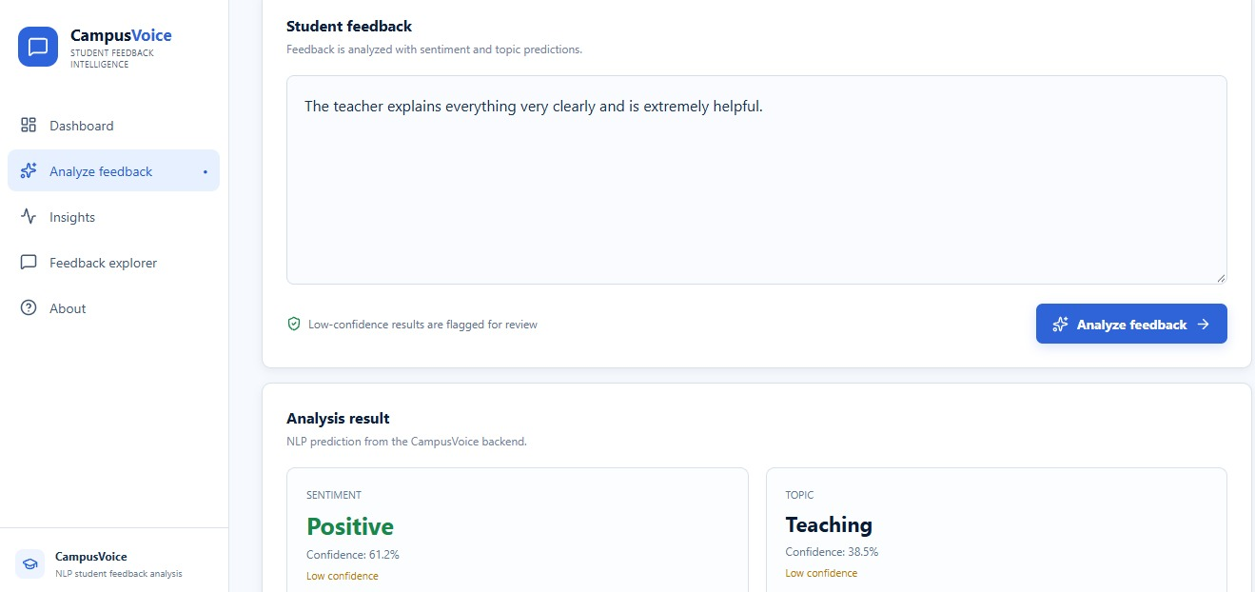
05 • ACTUAL OUTPUT
Working application: sentiment analysis
These are real outputs from the completed CampusVoice application.
NEGATIVE • “The facilities are terrible and the equipment keeps breaking.”
POSITIVE • “The teacher explains everything very clearly and is extremely helpful.”
CAMPUSVOICE • NLP STUDENT FEEDBACK INTELLIGENCE
05

Slide 6
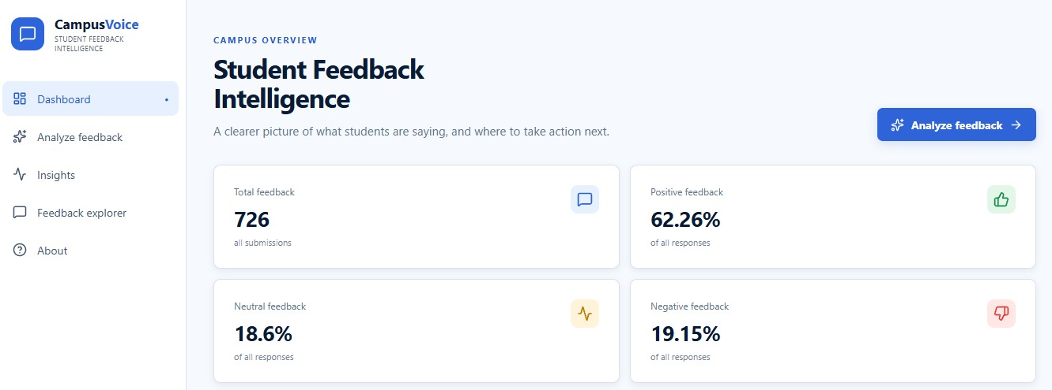
06 • APPLICATION RESULTS
From NLP predictions to dashboard insights
The individual sentiment predictions are aggregated into an interpretable campus overview.
62.26%
18.60%
19.15%
726
The dashboard makes the NLP output understandable at a glance and helps identify where attention may be required.
Positive
Neutral
Negative
Total feedback
CAMPUSVOICE • NLP STUDENT FEEDBACK INTELLIGENCE
06

Slide 7
07 • CONCLUSION
Key contribution and future scope
CampusVoice demonstrates a complete NLP workflow from raw text to usable feedback intelligence.
Main contribution
Future NLP scope
• End-to-end student feedback NLP pipeline
• Preprocessing + negation-aware handling
• Word and character TF-IDF feature engineering
• Logistic Regression sentiment and category models
• Hybrid ML + VADER + domain rules
• Confidence-aware predictions
• FastAPI + React application for practical use
• Larger and more diverse datasets
• Multilingual sentiment analysis
• Aspect-based sentiment analysis
• BERT / transformer models
• Semester-wise trend analysis
• Recurring-issue detection
• Human-in-the-loop correction for low-confidence predictions
CampusVoice
Every student voice deserves to be understood.
CAMPUSVOICE • NLP STUDENT FEEDBACK INTELLIGENCE
07

